Slide 1
Topics: Optimize and automate
Explain what it means to optimise and automate (Zendesk)
Display and explain the relationship between our guiding principle and values for the company
Explain what implementing the guiding principle achieves within the company (what positive effect it will have)
Explain the sort of ripple effect the implementation of this principle will occur (speed and quality increase, increase in user/customer satisfaction increase)
Examples of the principle in current use
Use a display to show speed increase by removing steps in a process.
Meaning
Example relating to irl
Pros and cons
How to implement
Present from the customer perspective (slideshow of steps taken)
Expand time using a lot of images
https://www.knowledgehut.com/tutorials/itil4-tutorial/itil-guiding-principles
https://www.itsmf.co.uk/itil4-guiding-principles-whats-this-all-about/
Optimize to do it right. Automate to do it efficiently. https://orangematter.solarwinds.com/2020/01/16/applying-itil-4-guiding-principles-service-desk/

Slide 2
Explain what it means to optimise and automate
Optimising and automation is when a process has had as many steps removed as possible to streamline the process from input to output
Image displaying a flow diagram of lots of steps
This speeds up the process resulting in higher value for the business.
Speed has a direct relationship with a companies value due to the cost of time and customer satisfaction.
A slow system or process is normally determined by the amount of steps in a process that requires human interaction.
Image displaying the reduction of speed when a process contains human interaction
Take customer service for an example, If every ticket submitted was only sent to one user then forwarded manually to others. The time take to forward the ticket is wasted costing the company time, when a customer has to wait they begin to dislike the service they are receiving both resulting in the company loosing value.

Slide 3
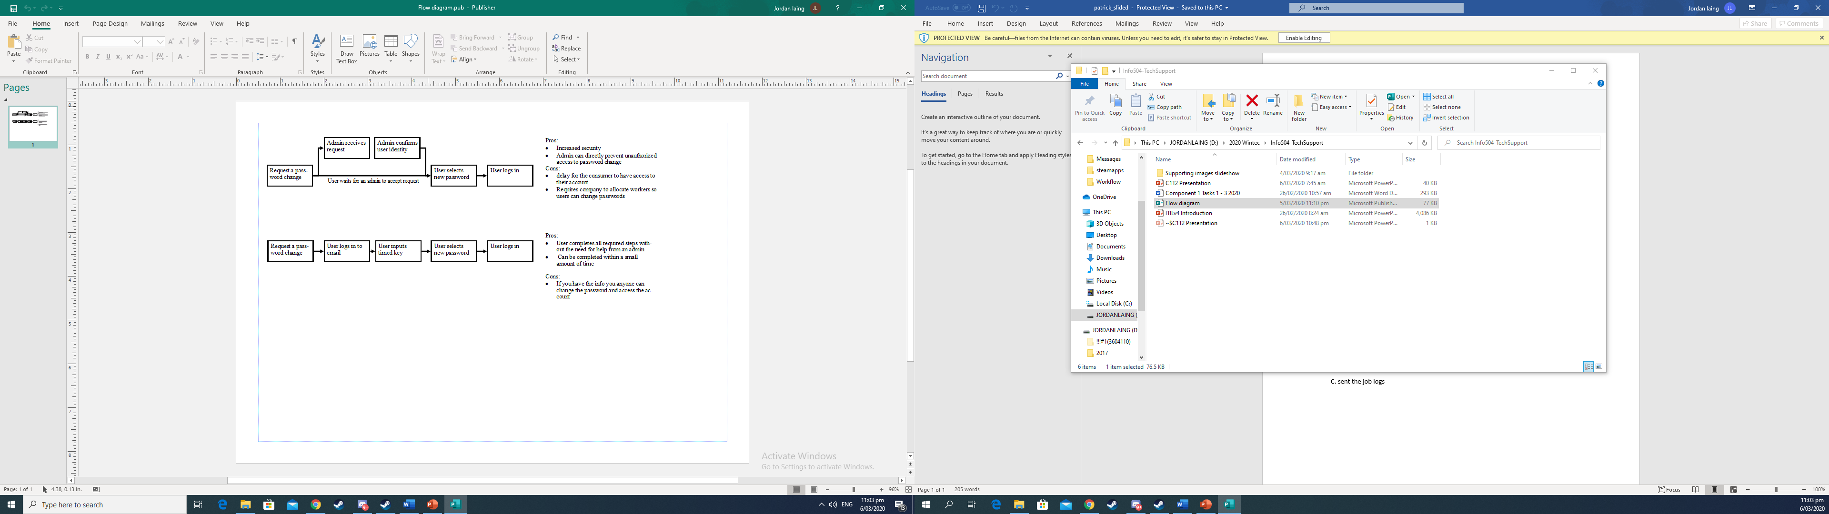
Positives and Negatives

Slide 4
Optimise and Automate
Optimize and Automate, one of the guiding principles for ITIL v4. Means to cut away steps from a process, allowing more resources in the company to be fully utilized reducing cost. Human intervention should only occur when it benefits the company.

Slide 5
Example of a process
This flowchart displays the process taken within two different companies resetting a user’s password.

Slide 6
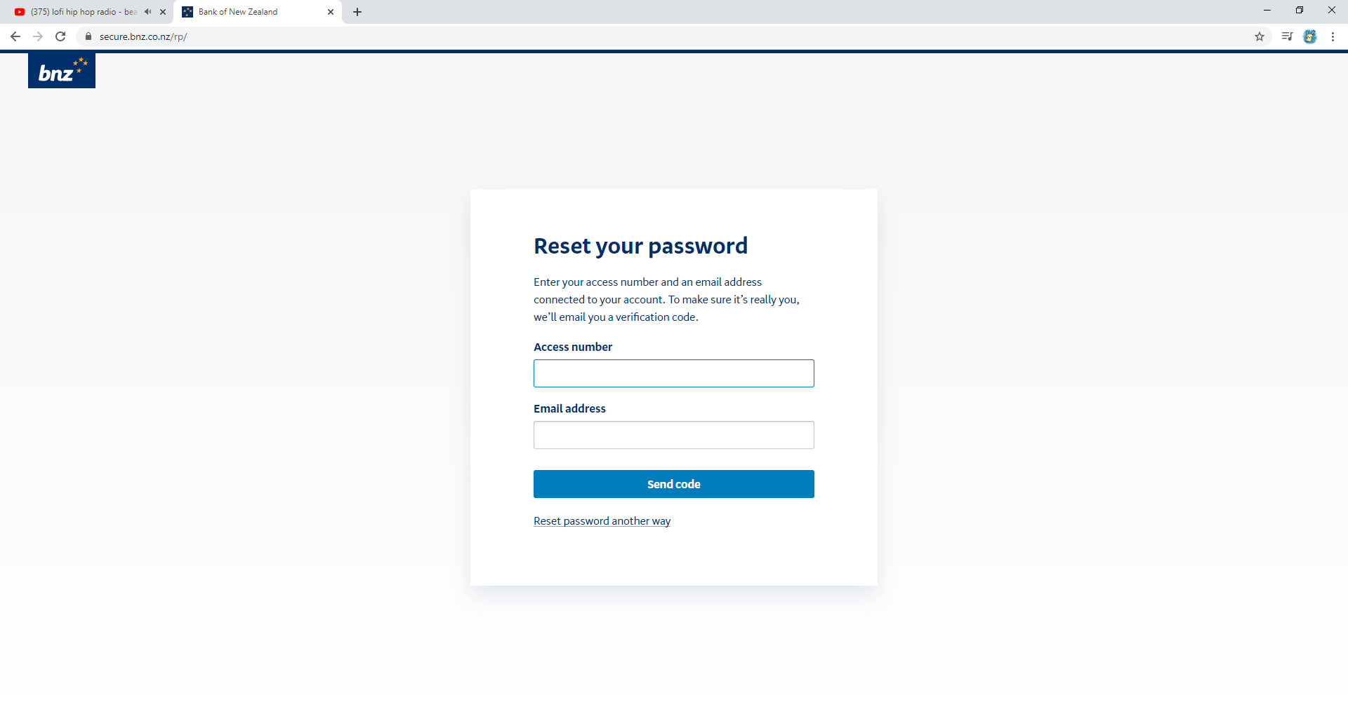
Email addresses are normally used to identify the user
All websites include multiple ways to identify the user including contacting support

Slide 7
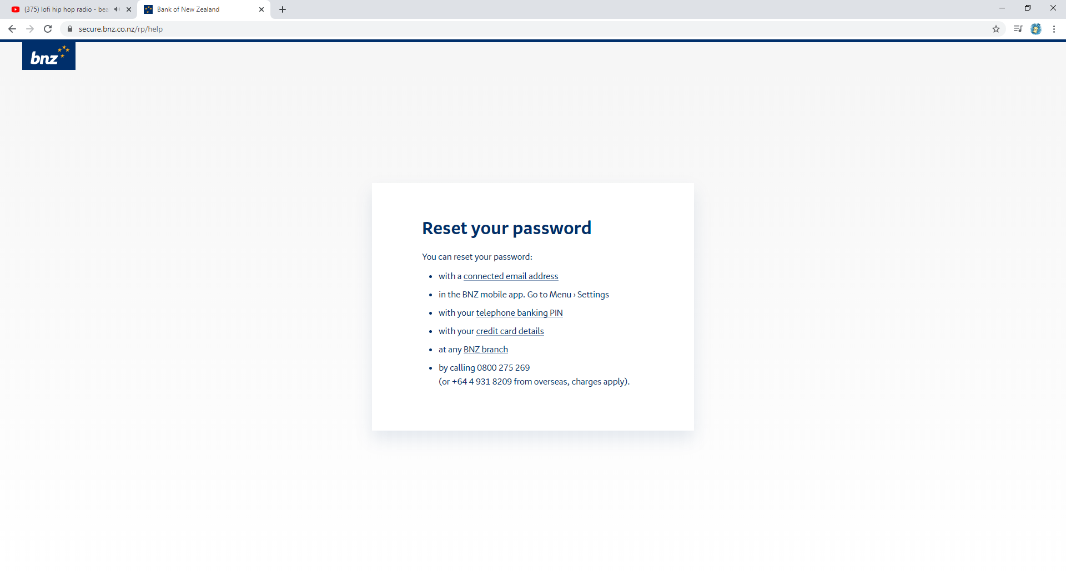
This website shows most of the ways that you normally change your login
Instore
Calling support
With other unique identification(linked card information, phone number, Ect)
Connected accounts (Email)

Slide 8
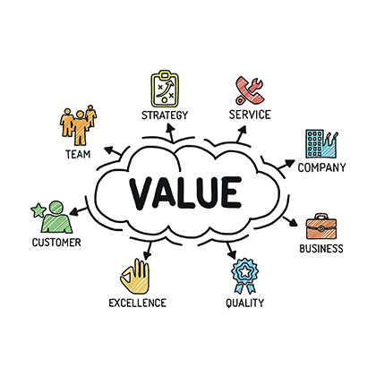
Value
Value within a business is a term to define the health and well-being of the company.
Types of value can include:
Customer Value
Shareholder Value
Employee Knowledge
Channel Partner Value

Slide 9
Relationship with Value
Optimizing and automating within a tech support field:
Reduces cost for labor
Speeds up processing time
Increases customer satisfaction
Within tech support multiple fields of value benefit from one change.
Like in the password change example removing the need to contact support increases speed for the customer to have their new password, which increases customer satisfaction and it also decreases the amount of labor you hire to work the support desk.

Slide 10
Implementation
Optimising and automation is when a process has had as many steps removed as possible to streamline the process.
So when following the guiding principle you automate processes and optimize processes when you cant automate.

